Slide 1



PREDICTIVE ANALYSIS OF ACQUISITIONS
PRESENTED BY TEAM 14
The analysis provides insights which will be helpful in for New tech companies and economic growth of the country

Slide 2

TABLE OF CONTENT
ABSTRACT
PROJECT AREA LITERATURE SURVEY
PROBLEM OBJECTIVES MOTIVATION
DATA SET
TECHNIQUES PROGRESS
CONCLUSION REFERENCES

Slide 3



ABSTRACT
The process of mergers and acquisitions has gained substantial importance in today's corporate world. This process is extensively used for restructuring business organizations. In India, the concept of mergers and acquisitions was initiated by government bodies. Some well-known financial organizations also took the necessary initiatives to restructure the corporate sector of India by adopting the mergers and acquisitions policies.

Slide 4


PROJECT AREA
Our Project Deals with Visualizing the enormous Data Set which contains Data
regarding all the giant acquisitions made by tech giants and Generating value insights
that can be used to make critical business Decisions. Major Sector which we influence with this research is the corporate and
economic sector of the country.

Slide 5
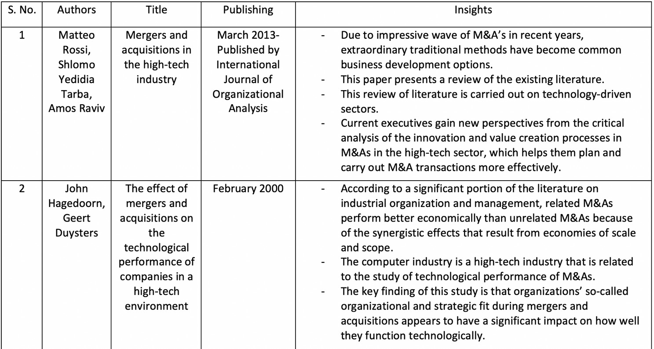

LITERATURE SURVEY

Slide 6

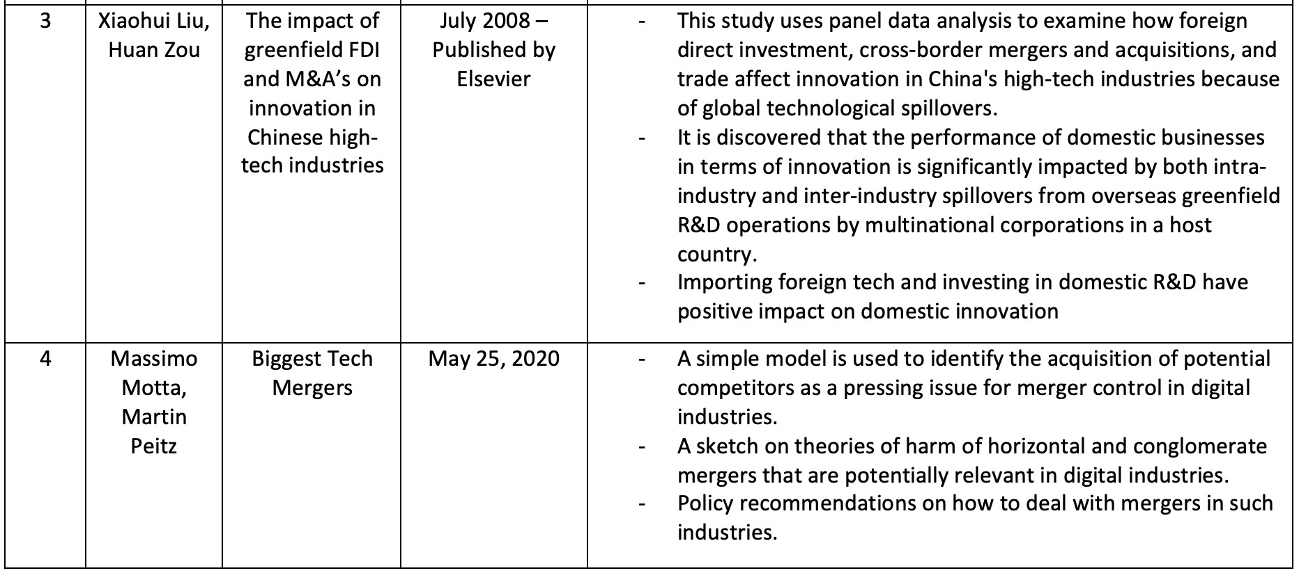

Slide 7

PROBLEM STATEMENT
Over the period of t ime, every tech company present
in the world has started to acquire smaller companies with potential for their own gain, These smaller
acquisitions have proven to be a game changer both to the company and also to the origin country's
economic growth,
As India is one of the fastest developing countries, i t is also the homeland for various startups and
innovations,
Our main motto is to study and understand the trends of the different acquisitions over a period of t ime and then generate the insights which can be used by
different startups in India by promoting their growth at the global level and in doing so promoting the
economic growth of our country too.

Slide 8


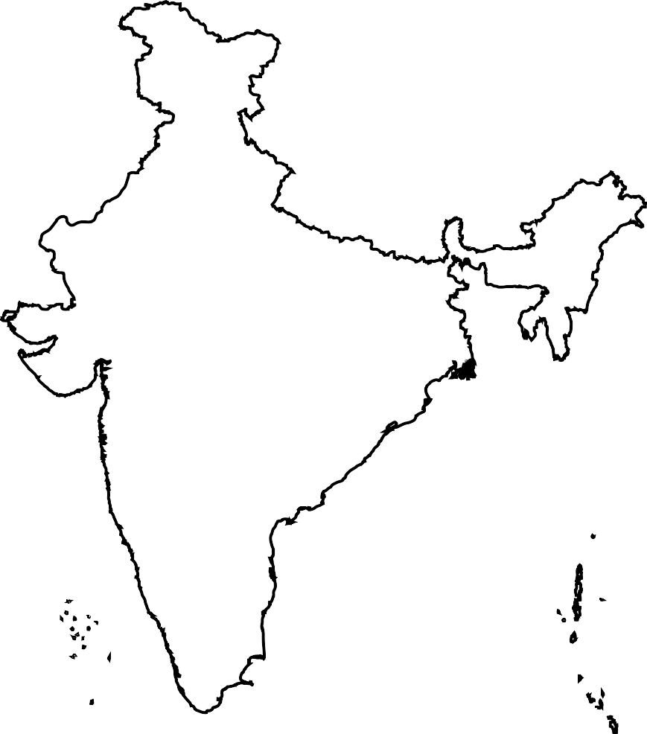

MOTIVATION
Throughout the world everyday, the world witness major economic exchanges everyday, Acquisitons play major role in those economic exchanges.
India is a growing nation, with lot of the hidden
potential in i t , The nation promotes the new start- up and technologies by providing the required
support to them, The nation even introduced
MAKE IN INDIA concept to promote the same, but in order for a plan or scheme to work, proper
study of the f ield they are working and a proper planning is neccessary , we with the analysis are providing both a plan and proof for The nation to act , so that i t would shine on the universal desk.

Slide 9

DATA SET
We Found a Data set on kaggle relatable to the concept which we are researching on, as the
research topic we chose is more dynamic in nature,it will require latest dataset and value
figures,for that we will utilyzing multiple datasets
,regarding the startups and acquisitions made in
different devloped nations and how they promoted the economic situation of the nation
We Also are referring to the startup data of the
nation, to try and understand,different feilds which might effect the economic conditions drastically.
DATASET FILES :acquisitions_update_2021.csv
startupdata_India_feb22.csv

Slide 10
TECHNIQUES
. Descriptive analysis - What happened?
The descriptive analysis method is the starting point to any analytic
reflection, and i t aims to answer the question of what happened? I t does this by ordering, manipulating, and interpreting raw data from various sources to turn i t into valuable insights for your organization.
Performing descriptive analysis is essential, as i t allows us to present our insights in a meaningful way. Although i t is relevant to mention that this
analysis on i ts own will not allow you to predict future outcomes or tell you
the answer to questions l ike why something happened, i t will leave your data organized and ready to conduct further investigations.
. Exploratory analysis - How to explore data relationships.
As i ts name suggests, the main aim of the exploratory analysis is to explore. Prior to i t , there was still no notion of the relationship between the data and the variables. Once the data is investigated, the exploratory analysis enables you to f ind connections and generate hypotheses and solutions for specific problems. A typical area of application for i t is data mining.

Slide 11

TECHNIQUES
. Diagnostic analysis - Why i t happened .
Diagnostic data analytics empowers analysts and executives by helping them gain a f i rm contextual understanding of why something happened. I f you know why something
happened as well as how i t happened, you will be able to pinpoint the exact ways of tackling the issue or challenge.
Designed to provide direct and actionable answers to specific questions, this is one of the world’ s most important methods in research, among i ts other key organizational
functions such as retail analytics, e. g.
. Predictive analysis - What will happen?
The predictive method allows you to look into the future to answer the question: what will happen? In order to do this, i t uses the results of the previously mentioned
descriptive, exploratory, and diagnostic analysis, in addition to machine learning ( ML) and artificial intelligence ( AI). Like this, you can uncover future trends, potential
problems or inefficiencies, connections, and casualties in your data.
With predictive analysis, you can unfold and develop initiatives that will not only
enhance your various operational processes but also help you gain an all- important edge on the competition. I f you understand why a trend, pattern, or event happened through data, you will be able to develop an informed projection of how things may unfold in particular areas of the business.

Slide 12
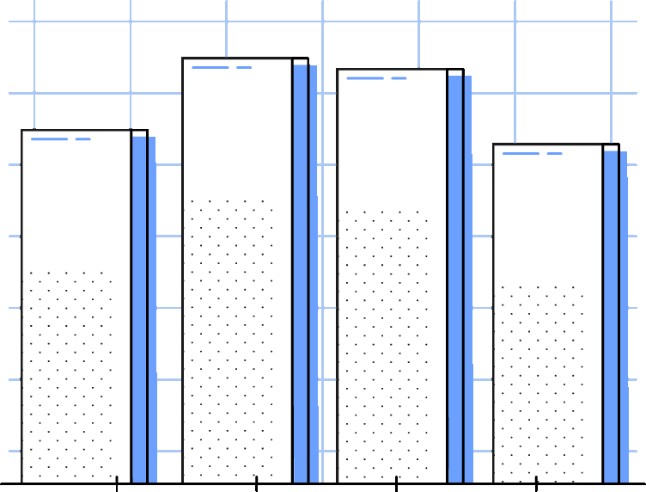

PROGRESS OF PROJECT
We have collected the data sets related to the
project area, we also performed the pre-processing techniques to it and cleansed the data to make it
useful to the analysis we are trying to perform. The main objectives which we want to perform :
Analysis of previous trends -Descriptive analysis Understand how it happened-Diagnostic analysis Predict the future changes which might occur
We Have created an exploratory data analysis of
the data as part of the first objective, we analyzed the trends of the timeline.
We have attached the screenshots of the
exploratory data analysis of the data in next slides

Slide 13
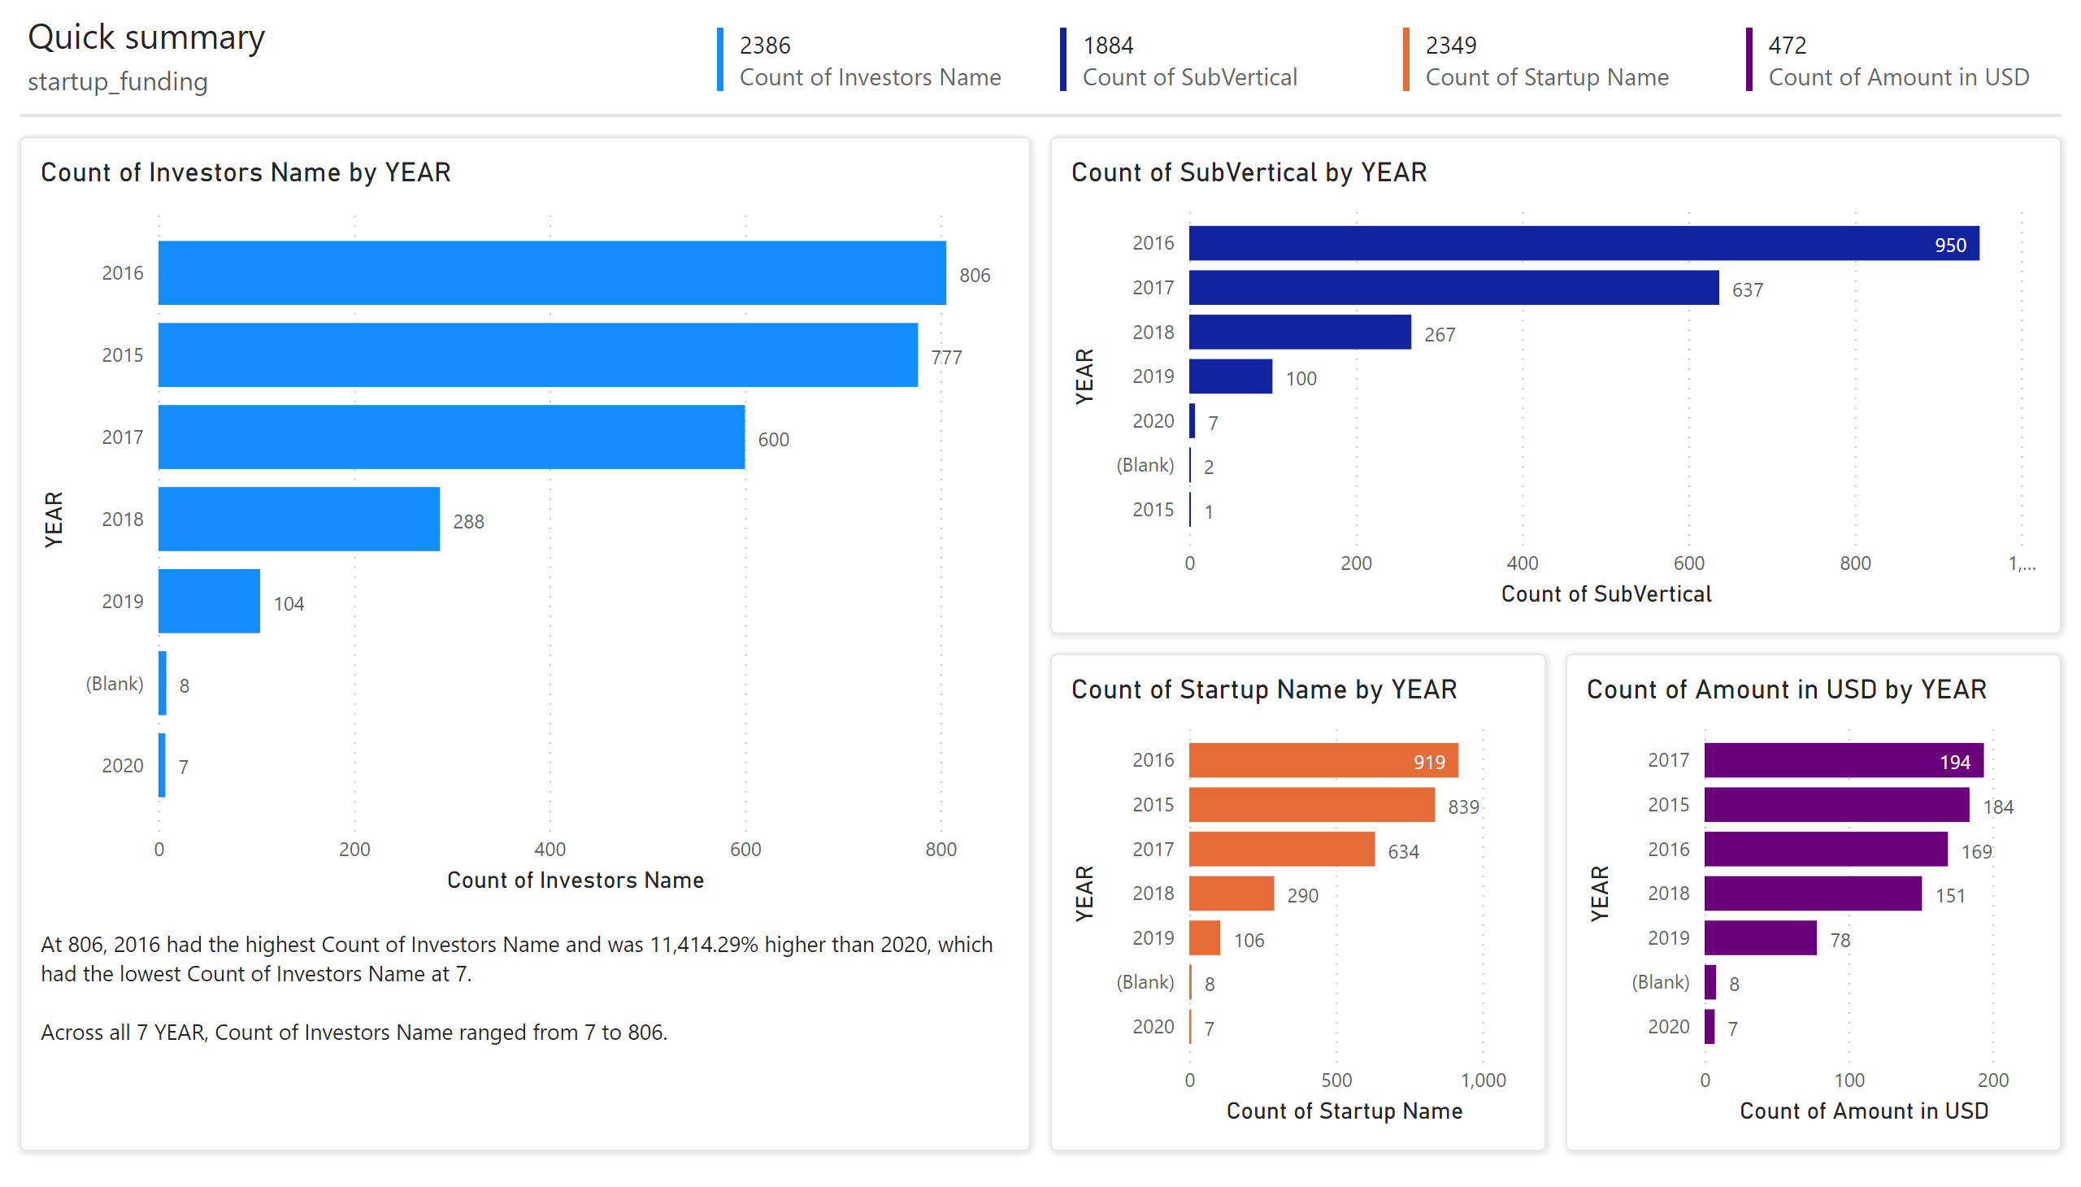
Page 1
Notes:
clusteredBarChart
No alt text provided
clusteredBarChart
No alt text provided
clusteredBarChart
No alt text provided
clusteredBarChart
No alt text provided
shape
No alt text provided
textbox
No alt text provided
shape
No alt text provided
shape
No alt text provided
shape
No alt text provided
textbox
No alt text provided
textbox
No alt text provided
multiRowCard
No alt text provided
multiRowCard
No alt text provided
multiRowCard
No alt text provided
multiRowCard
No alt text provided
shape
No alt text provided

Slide 14

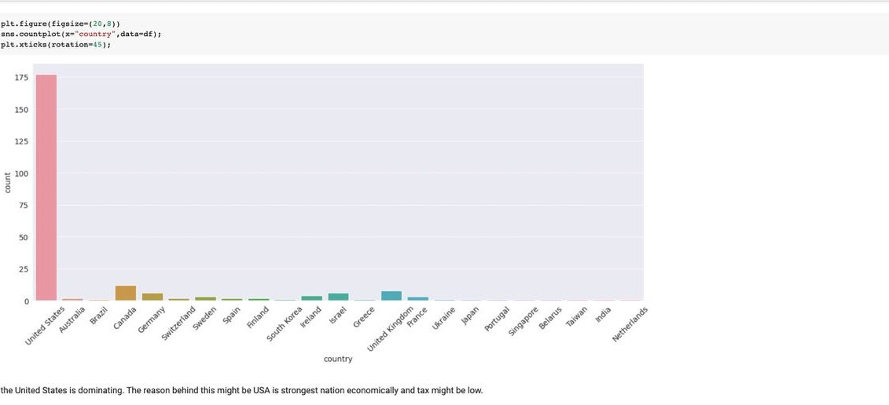
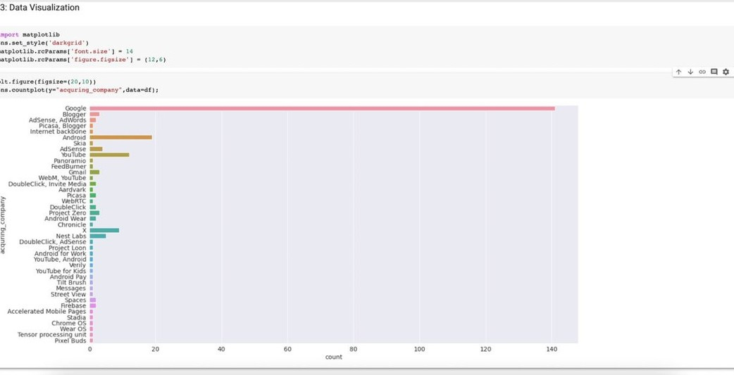
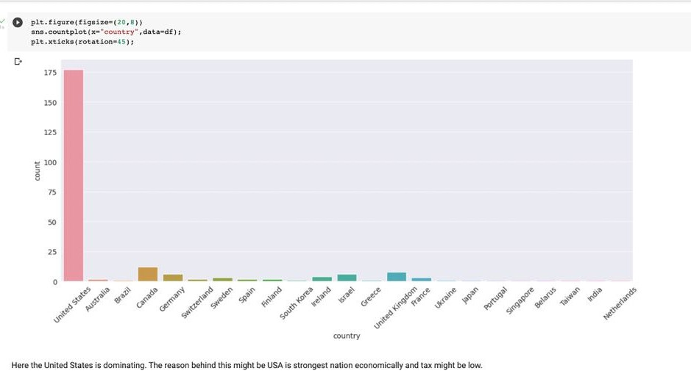
CODE EXECTION SNIPPETS

Slide 15

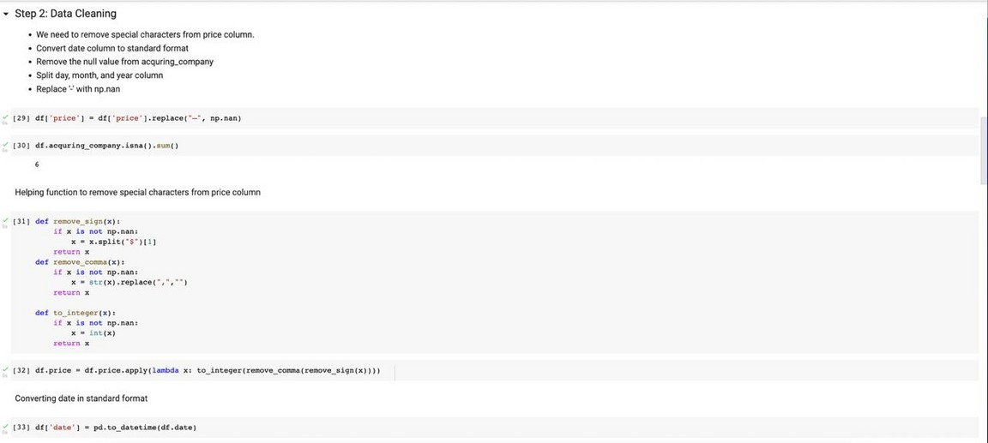
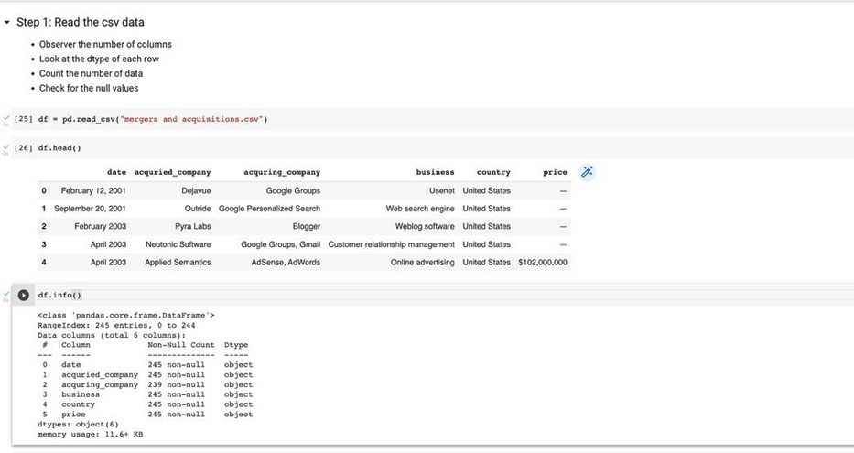
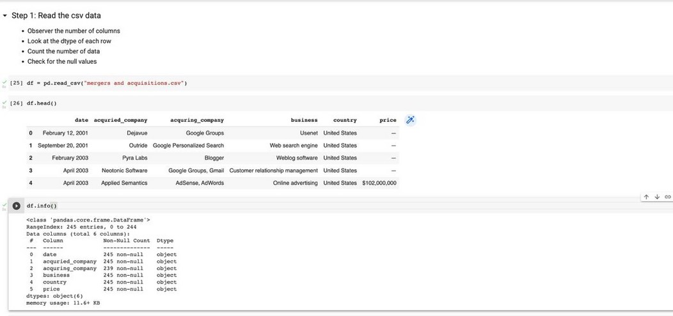
CODE SNIPPETS

Slide 16



TOOLS USED

Slide 17



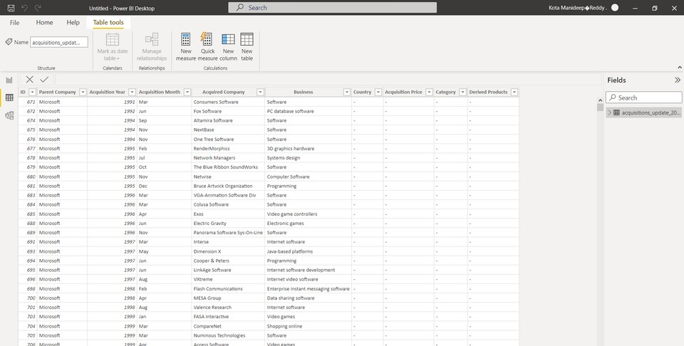
POWER BI
Power BI is a cloud-based tool that requires no capital expenditure or infrastructure support regardless of the size of a business. The modern iteration of the tool is free from legacy software constraints and its users do not need any specialised training in order to generate business intelligence insights. Typical of all Microsoft cloud services, implementation of Power BI embedded is rapid and
trouble-free
We are using this tool mainly to format data and to filter Data for our usage and also to integrate a machine learning algorithm which will do predictive analysis using regression techniques .

Slide 18
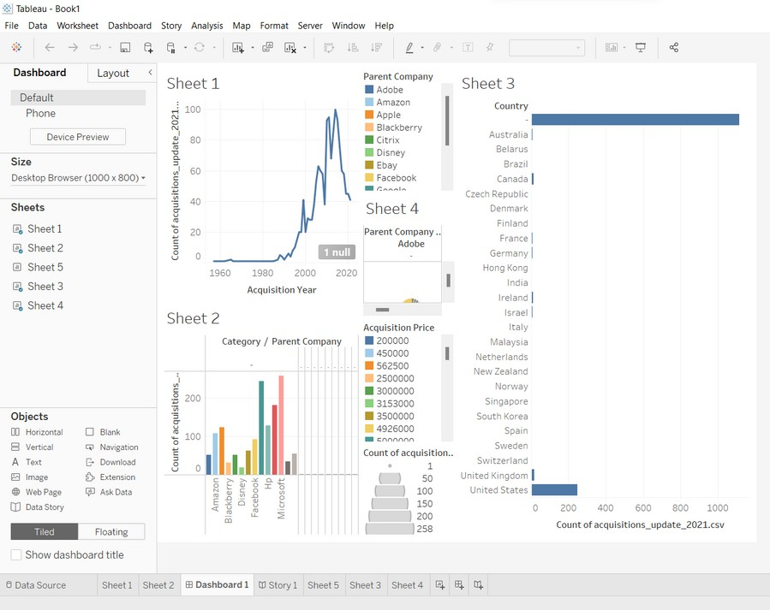
TABLEAU
What is Tableau?
Tableau is a powerful and fastest- growing data visualization tool used in the Business Intelligence Industry. I t helps in
simplifying raw data in a very easily understandable format.
Tableau helps create data that can be understood by
professionals at any level in an organization. I t also allows non- technical users to create customized dashboards.
Data analysis is very fast with the Tableau tool and the
visualizations created are in the form of dashboards and worksheets.
We are using Tableau for visualizing the Data acquired after the f i l tering and turning them into graphs that the stakeholders
could use to take critical decisions.

Slide 19

CONCLUSION
M&A executives are sending clear and strong signals that deal-making activity—acquisitions, divestitures, and
alternative M&A strategies—will provide important levers for businesses as they continue to navigate regulatory
tightening and an evolving economic environment.
"Adaptting, antticipatting, and innovatting"
This is the motto followed by the Different Tech Giants, to keep their business up and running
Government's support!
The Indian economic reform since 1991 has opened up a whole lot of challenges both in the domestic and
international spheres. The increased competition in the global market has prompted Indian companies to go for
mergers and acquisitions as an important strategic choice.
The trends of mergers and acquisitions in India have changed over the years.

Slide 20
THANK YOU
BY TEAM 14, 2010030309-K MANIDEEP REDDY
2010030082-PRANAY KANALA
2010030421-V.RITHVIK
2000030666 - MVS SAITEJA

